Slide 1

Teaching Resources and Instructors’ Guidelines
Chapter 10: Creating new products and services

Slide 2
Chapter 10: Creating new products and services
In the following PowerPoint slides you will find the key headings from CHAPTER 10 together with the main illustrations, tables, etc.
There are also slides summarizing the key messages in bullet-point fashion, and a wide range of activities which you can use to help students explore around these themes.
Finally there are some reflection questions which can be used as the basis for discussion or assignments.

Slide 3
Learning Objectives
By the end of this chapter you will develop an understanding of:
a formal process to support new product development, such as stage-gate and the development funnel
product and organizational factors which influence success and failure
choosing and applying relevant tools to support each stage of product development
the differences between products and services and how these influence development
applying the lessons of diffusion research to promote the adoption of innovations.

Slide 4

Core themes and material from the book

Slide 5
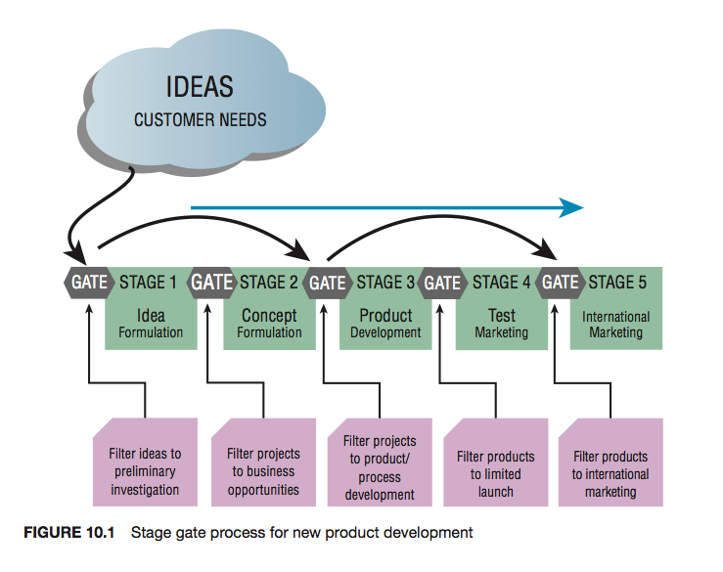
Implementation as a journey

Slide 6
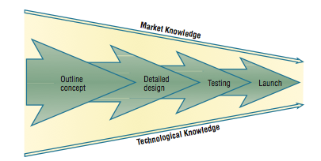
The development funnel
Figure 10.2 of the book presents the ‘development funnel’ showing that there is a structure in place which reviews both technical and marketing data at each stage

Slide 7
A simplified 4 stage model
• Concept generation – identifying the opportunities for new products and services.
• Project assessment and selection – screening and choosing projects which satisfy certain criteria.
• Product or service development – translating the selected concepts into a physical product or a new service.
• Product or service commercialization – testing, launching and marketing the new product or service.

Slide 8

Project selection
Two filters:
Aggregate product plan – attempts to integrate the various potential projects to ensure that the collective set of development projects meet the goals and objectives of the firm, and help to build the capabilities needed.
Developing specific product concepts. The two most common processes at this level are the development funnel and the stage gate system.

Slide 9

Product development
This stage includes all the activities necessary to take the chosen concept and deliver a product or service for commercialization.

Slide 10
Success factors in new product development
• Product advantage
• Market knowledge
• Clear product definition
• Risk assessment
• Project organization
• Project resources
• Proficiency of execution
• Top management support

Slide 11
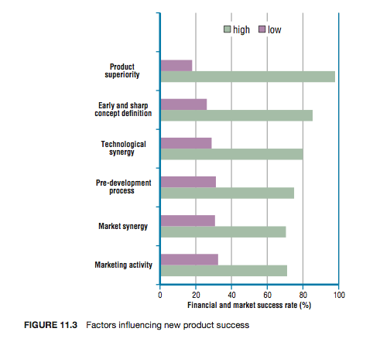
Winning at new products

Slide 12
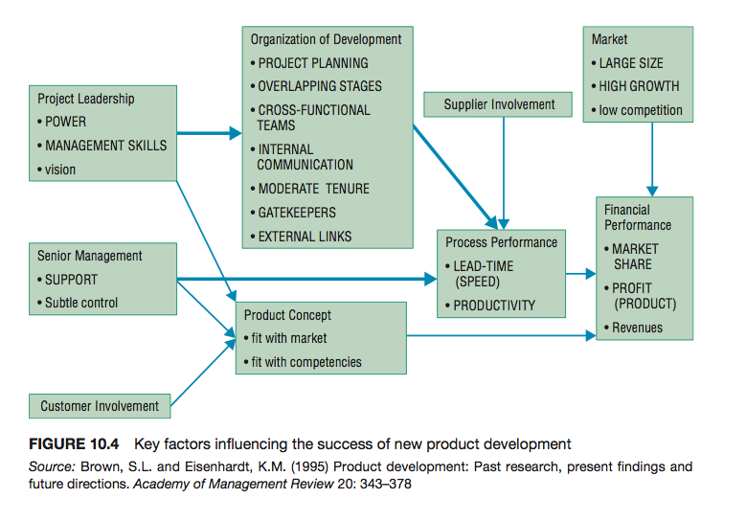
Product development influential factors

Slide 13
Concept generation
On the website there are several tools to help with concept generation, for example:
Design methods
Creativity tools
Competitiveness profiling
Value curves
Lead user methods
Market research tools

Slide 14
Concept generation
Follow the link below to hear a podcast on how market research marked a shift from a producer-led to a consumer-led approach to business
https://www.bbc.co.uk/programmes/w3csv3gm

Slide 15
Quality function deployment
Identify customer requirements, primary and secondary, and any major dislikes.
Rank requirements according to importance.
Translate requirements into measurable characteristics.
Establish the relationship between the customer requirements and technical product characteristics, and estimate the strength of the relationship.
Choose appropriate units of measurement and determine target values based on customer requirements and competitor benchmarks.

Slide 16
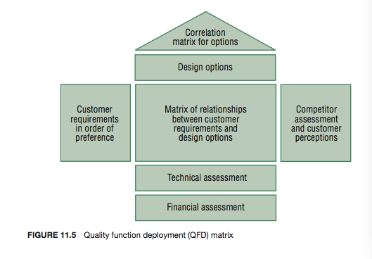
QFD matrix
Figure 10.8 of the book presents QFD matrix that was originally developed in Japan and claimed to have helped Toyota reduce its development time and costs by 40 %

Slide 17
Differences between products and services
  Tangibility.
  Perceptions of service quality:
    tangible aspects;
    responsiveness;
    competence;
    assurance;
    empathy.
  Simultaneity.
  Storage.
  Customer contact.
  Location.

Slide 18
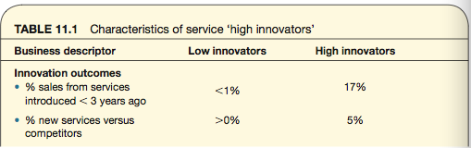
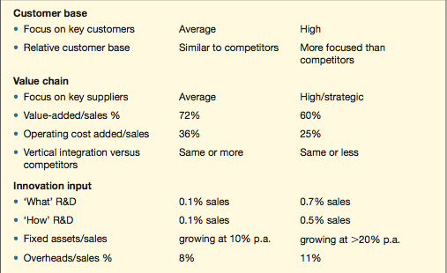
Characteristics of service innovators

Slide 19
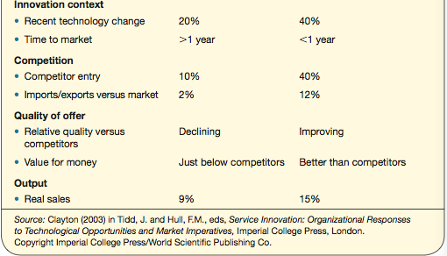
Characteristics of service innovators continued

Slide 20
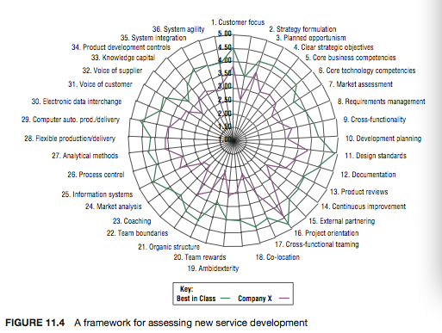
Success factors in service innovation: the SPOTS model

Slide 21
SPOTS model
There is a full description of the model on the website here

Slide 22
Diffusion of innovations
Diffusion is the means by which innovations are translated into social and economic benefits.
We know that the impact of the use of innovations is around four times that of their generation
However, the benefits of innovations can take 10–15 years to be fully effected, and in practice most innovations fail to be adopted widely, and so have limited social or economic impact.

Slide 23
Rogers’ definition
Rogers’ definition of diffusion is used widely:
‘the process by which an innovation is communicated through certain channels over time among members of a social system. It is a special type of communication, in that the messages are concerned with new ideas’

Slide 24
Rogers’ 3 types of innovation decision
• Individual, in which the individual is the main decision-maker, independent of peers. Decisions may still be influenced by social norms and interpersonal relationships, but the individual makes the ultimate choice. For example, the purchase of a consumer durable such as a mobile phone.

Slide 25
Rogers’ 3 types of innovation decision
• Collective, where choices are made jointly with others in the social system, and there is significant peer pressure or formal requirement to conform. For example, the sorting and recycling of domestic waste.
• Authoritative, where decisions to adopt are taken by a few individuals within a social system, owing to their power, status or expertise (e.g. adoption of ERP systems by businesses, or MRI systems by hospitals).

Slide 26
Models of diffusion
In practice the precise pattern of adoption of an innovation will depend on the interaction of demand-side and supply-side factors:
• Demand-side factors – direct contact with or imitation of prior adopters, adopters with different perceptions of benefits and risk.
• Supply-side factors – relative advantage of an innovation, availability of information, barriers to adoption, feedback between developers and users.

Slide 27
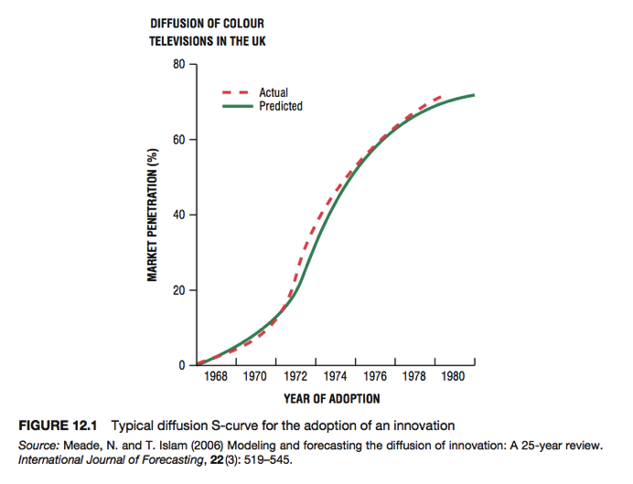
The S-curve

Slide 28
Barriers to adoption
• economic – personal costs versus social benefits, access to information, insufficient incentives
• behavioural – priorities, motivations, rationality, inertia, propensity for change or risk
• organizational – goals, routines, power and influence, culture and stakeholders
• structural – infrastructure, sunk costs, governance.

Slide 29
Factors affecting diffusion
In predicting the rate of adoption of an innovation, five factors explain 49–87% of the variance:
• relative advantage
• compatibility
• complexity
• trialability
• observability.

Slide 30
Relative advantage
Relative advantage is the degree to which an innovation is perceived as better than the product it supersedes, or competing products.
Typically measured in narrow economic terms, for example cost or financial payback
Non-economic factors such as convenience, satisfaction and social prestige may be equally important.

Slide 31
Attributes of innovation
Primary attributes, such as size and cost, are invariant and inherent to a specific innovation irrespective of the adopter.
Secondary attributes, such as relative advantage and compatibility, may vary from adopter to adopter, being contingent upon the perceptions and context of adopters.

Slide 32

Compatibility
Compatibility is the degree to which an innovation is perceived to be consistent with the existing values, experience and needs of potential adopters.
Two distinct aspects of compatibility:
  existing skills and practices,
  and values and norms.
Few innovations initially fit the user environment into which they are introduced. Significant misalignments between the innovation and the adopting organization will require changes in the innovation or organization, or, in the most successful cases of implementation, mutual adaptation of both.

Slide 33

Complexity
Complexity is the degree to which an innovation is perceived as being difficult to understand or use.
In general, innovations which are simpler for potential users to understand will be adopted more rapidly than those which require the adopter to develop new skills and knowledge.

Slide 34
Trialability
Trialability is the degree to which an innovation can be experimented with on a limited basis.
An innovation that is trialable represents less uncertainty to potential adopters, and allows learning by doing. Innovations which can be trialled will generally be adopted more quickly than those which cannot.
Sometimes called ‘divisibility’ – how far can the risk of adoption be broken down into small steps rather than requiring a full commitment at the outset

Slide 35
Observability
Observability is the degree to which the results of an innovation are visible to others.
The easier it is for others to see the benefits of an innovation, the more likely it will be adopted.
The simple epidemic model of diffusion assumes that innovations spread as potential adopters come into contact with existing users of an innovation.

Slide 36
Checklist: Relative advantage
• How well does my plan show how much better off people will be when they adopt it?
• Why is this plan better than what has been done before?
• What advantages or benefits may there be to accepting the plan?
• Who will gain from the implementation of the plan?
• How will I (or others) be rewarded by adopting the plan?
• How can I emphasize the plan’s benefits to all?

Slide 37
Checklist: Compatibility
How well does my plan demonstrate that it is compatible with current values, past experiences and needs?
Is the plan consistent with current practice?
Does the plan meet the needs of a particular group?
Does it offer better ways to reach our common goals?
Who will naturally support and agree with the plan?
Can it be favourably named, packaged or presented?

Slide 38
Checklist: Trialability
How well does my plan allow for trialability?
Can the plan be tried out or tested?
Can uncertainty be reduced?
Can we begin with a few parts of the plan?
How can others be encouraged to try out the plan?
Can the plan be modified by you or others?

Slide 39
Checklist: Complexity
How well does my plan provide for easy communication, comprehension and use?
Is the plan easy for others to understand?
Can it be explained clearly to many different people?
Will the plan be easily communicated?
How can the plan be made more simple or easy to understand?
Is the plan easy to use or follow?

Slide 40
Checklist: Observability
How well does my plan provide results that are easily observed and visible to others?
Is the plan easy for others to find or obtain?
Can the plan be made more visible to others?
How can I make the plan easier for others to see?
Will others be able to see the effects of the plan?
Are there good reasons for not making the entire plan visible?

Slide 41
Checklist: Other factors
What other resources will I need; how can I get them?
What obstacles exist; how can we prevent or overcome them?
What new challenges will be created; and dealt with?
How can I encourage commitment to the plan?
What feedback about the plan is needed?

Slide 42
Summary
The process of innovation is much more complex than technology responding to market signals. Effective business planning under conditions of uncertainty demands a thorough understanding and management of the dynamics of innovation, including conception, development, adoption and diffusion.

Slide 43
Summary
The adoption and diffusion of an innovation depend on the characteristics of the innovation, the nature of potential adopters and the process of communication. The relative advantage, compatibility, complexity, trialability and observability of an innovation all affect the rate of diffusion.

Slide 44
Summary
Forecasting the development and adoption of innovations is difficult, but participative methods such as Delphi and scenario planning are highly relevant to innovation and sustainability. In such cases the process of forecasting, including consultation and debate, is probably more important than the precise outcomes of the exercise.

Slide 45
Summary
There is a vast amount of management research on the subject of new product and service development, and we are now pretty certain what works and what does not. There are no guarantees that following the suggestions in this chapter will produce a blockbuster product, service or business, but if these elements are not managed well, your chances of success will be much lower. This is not supposed to discourage experimentation and calculated risk-taking but rather to provide a foundation for evidence-based practice.

Slide 46
Summary
Research suggests that a range of factors affect the success of a potential new product or service:
Some factors are product-specific (e.g. product advantage, clear target market and attention to pre-development activities).
Other factors are more about the organizational context and process (e.g. senior management support, formal process and use of external knowledge).

Slide 47
Summary
  A formal process for new product and service development should consist of distinct stages, such as concept development, business case, product development, pilot and commercialization, separated by distinct decision points, or gates, which have clear criteria, such as product fit and product advantages.

Slide 48
Summary
  Different stages of the process demand different criteria and different tools and methods. Useful tools and methods at the concept stage include segmentation, experimentation, focus groups and customer partnering; and at the development stage useful tools include prototyping, design for production and QFD.

Slide 49
Summary
  Services and products are different in a number of ways, especially intangibility and perceived benefits, and so will demand the adaptation of the standard models and prescriptions for new product development.
  The relative advantage, compatibility, complexity, trialability and observability of an innovation all affect the rate of diffusion.

Slide 50

Videos
There are several videos which can help explore and present the key themes of the chapter:
Project implementation
Stage gates in implementation
Success and failure in implementation
Agile implementation
Interview with Catherina van Delden, Innosabi about agile innovation
Notes:
Short videos

Slide 51
Media: NPD challenges
On the website there is a video showing Joe Tidd talking about the challenges of organizing new product development:
https://www.youtube.com/watch?v=uCVetZE3GlM

Slide 52
Media: NPD challenges
On the website there is a video interview with Armin Rau, Strategy Partner of Sicap talking about some of the innovation management challenges in working in the fast-moving world of software for mobile devices.

Slide 53
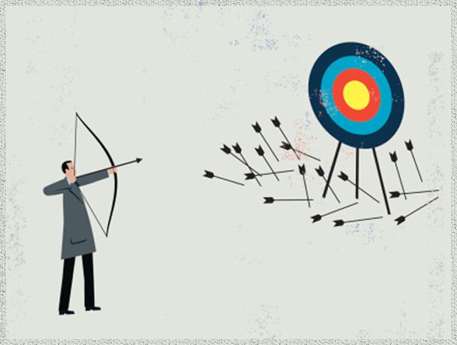
Media: Why products fail
On the website there is a video showing Joe Tidd talking about some of the reasons for product failure
https://www.youtube.com/watch?v=j8xPszggugU

Slide 54
Media: New product development
Follow the link below to listen to an interview with James Dyson
https://www.acast.com/howibuiltthis/dyson-james-dyson

Slide 55
Media: 3M
Eric von Hippel’s website has a series of videos describing 3M’s processes for seeking out breakthrough products and services:

Slide 56
Media: Capturing customer requirements
On the website there is a link to a video showing Joe Tidd talking about using QFD to help capture customer requirements
https://www.youtube.com/watch?v=Am9YXnmiKso
He also talks through the process of carrying out a QFD exercise for product development:
https://www.youtube.com/watch?v=PXXSAdwgr_w

Slide 57
Blogs and podcasts
There are several podcasts and blogs picking up key themes around creating new products and services and some of the key variables:

Slide 58
Activities
There are a variety of activities (for both groups and individuals and for online as well as offline work. These include:

Slide 59
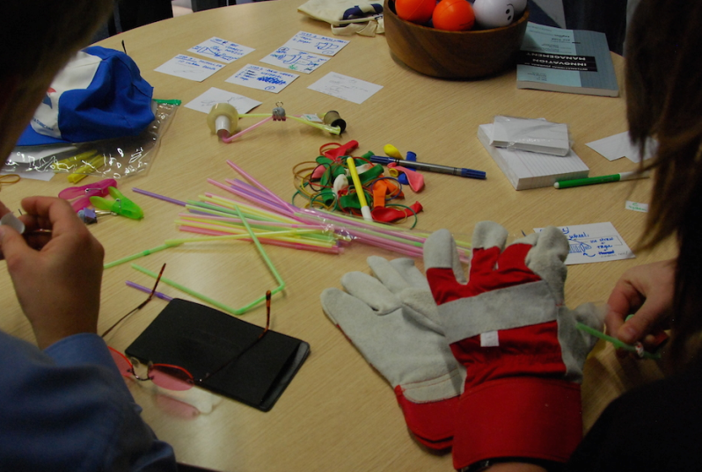
Activities: New product development game
On the website there is an exercise based on teams developing a new product which provides a platform for discussion and deeper exploration of key issues.

Slide 60
Team project exercises
Apply QFD to a real example of a new product or service. In a group, take the following steps:
Identify the target customer requirements, by market research or in class by ‘brain-storming’. Try to include both tangible and intangible elements.
Rank or weight these requirements, based on your best knowledge of the target market segment.
Where possible, translate the requirements into measurable characteristics.

Slide 61
Team exercises
On the website there is a tool ‘Accelerating diffusion’ and activity to help explore the adoption and diffusion of innovations
And a case study of Better Place, demonstrating the challenges of adoption and diffusion.

Slide 62
Cases
There are several case studies which highlight key themes in the chapter, including:
BBC
Bank of Scotland
Law firms innovation
Gordon Murray design
Lexus
Minimonos

Slide 63
Case-study: Jaguar
In March 2008 Tata bought Jaguar Land Rover from Ford for US $2.3 billion.
Since then, Tata has grown JLR through a sustained investment in new product development.
The mid-size luxury January XF was revealed in August 2007, with first customer deliveries in March 2008.
By 2011 Tata had tripled this annual R&D spend to £1.2 billion.
In 2010-2012 the company announced an investment of £355 million for new engine plant and altogether more than 3,000 new jobs were created.

Slide 64
Example: Murray Design
On the website there is a case study ‘Gordon Murray Design’ which illustrates these factors:

Slide 65
Example: Gunfire at sea
On the website there is a link to a famous study ‘Gunfire at sea’ highlighting the problem of compatibility and resistance to change arising from it

Slide 66
Example: Minimonos
On the website there is a video interview (Minimonos) with Melissa Clark-Reynolds which highlights some of these issues

Slide 67
Example: Plaswood Recycling
On the website there is a case ‘Plaswood recycling’ which highlights these factors:

Slide 68
Tools
There are a variety of tools which can help deal with themes raised in this chapter. You can find them here
Accelerating diffusion
Agile innovation and lean start-up
Conjoint analysis
Change management
Empathic design
Quality function deployment (QFD)

Slide 69
Tools to help with concept generation
Surveys and focus;
Latent needs analysis;
Lead-users;
Customer-developers;
Competitive analysis;
Industry experts or consultants;
Extrapolating trends;
Building scenarios;
Market experimentation.

Slide 70

Tools to help project selection – financial methods
Discounted cash flows, such as net present value/internal rate of return.
Cost-benefit analysis.
Simple calculations of the payback period.

Slide 71
Tools to help project selection – non-financial methods
Ranking.
Profiles.
Simulated outcomes.
Strategic clusters.
Interactive.

Slide 72
Tools to help product development
Design for Manufacture (DFM).
Rapid Prototyping.
Computer-aided Techniques (CAD/CAM).
Quality Function Deployment (QFD).
For more on these see the toolbox on the website:

Slide 73

Tool: Risk assessment matrix
On the website there is a description of this tool to help assess complexity issues

Slide 74
Accelerating diffusion
On the website there is a tool describing the use of models to help think about accelerating diffusion.
There is also an activity linked to this in the activities section

Slide 75
Assessments
The following slides offer some example assessment questions and discussion themes for individual or group activity

Slide 76
Assessment questions
1. What are the key differences between managing operations in services and manufacturing? Think of a business, and identify the relative contributions to value added by the service and physical product components.
2. To what extent do you think that manufacturing and services are converging? Try to think of an example of a manufacturing operation that increasingly features a service. Conversely, identify a service operation that is becoming more product-based.

Slide 77
Assessment questions
3. In what ways do think the development of new products differs from the development of new services?
4. Identify the relative importance of product/service attributes and organizational factors in successful development.
5. In practice, how many stages and gates do you think a process for new product development should have?

Slide 78
Assessment questions
6. What is the difference between the ‘stage-gate’ and ‘development funnel’ models of the new product development process?
What effect does the novelty of the new product or service have on the development process?
8. What factors influence the adoption of innovations, and which of these can be managed?

Slide 79
Discussion questions
Which components of a business plan are most important to attract resources?
How can forecasting be used to identify and reduce risk and uncertainty?
What is meant by the ‘fuzzy front end’ and how can it be better managed?
What is the difference between risk and uncertainty?
What are the relative advantages and disadvantages of using quantitative and qualitative methods for assessing projects?

